Slide 1


INTRODUCING
Our School Dog

Slide 2

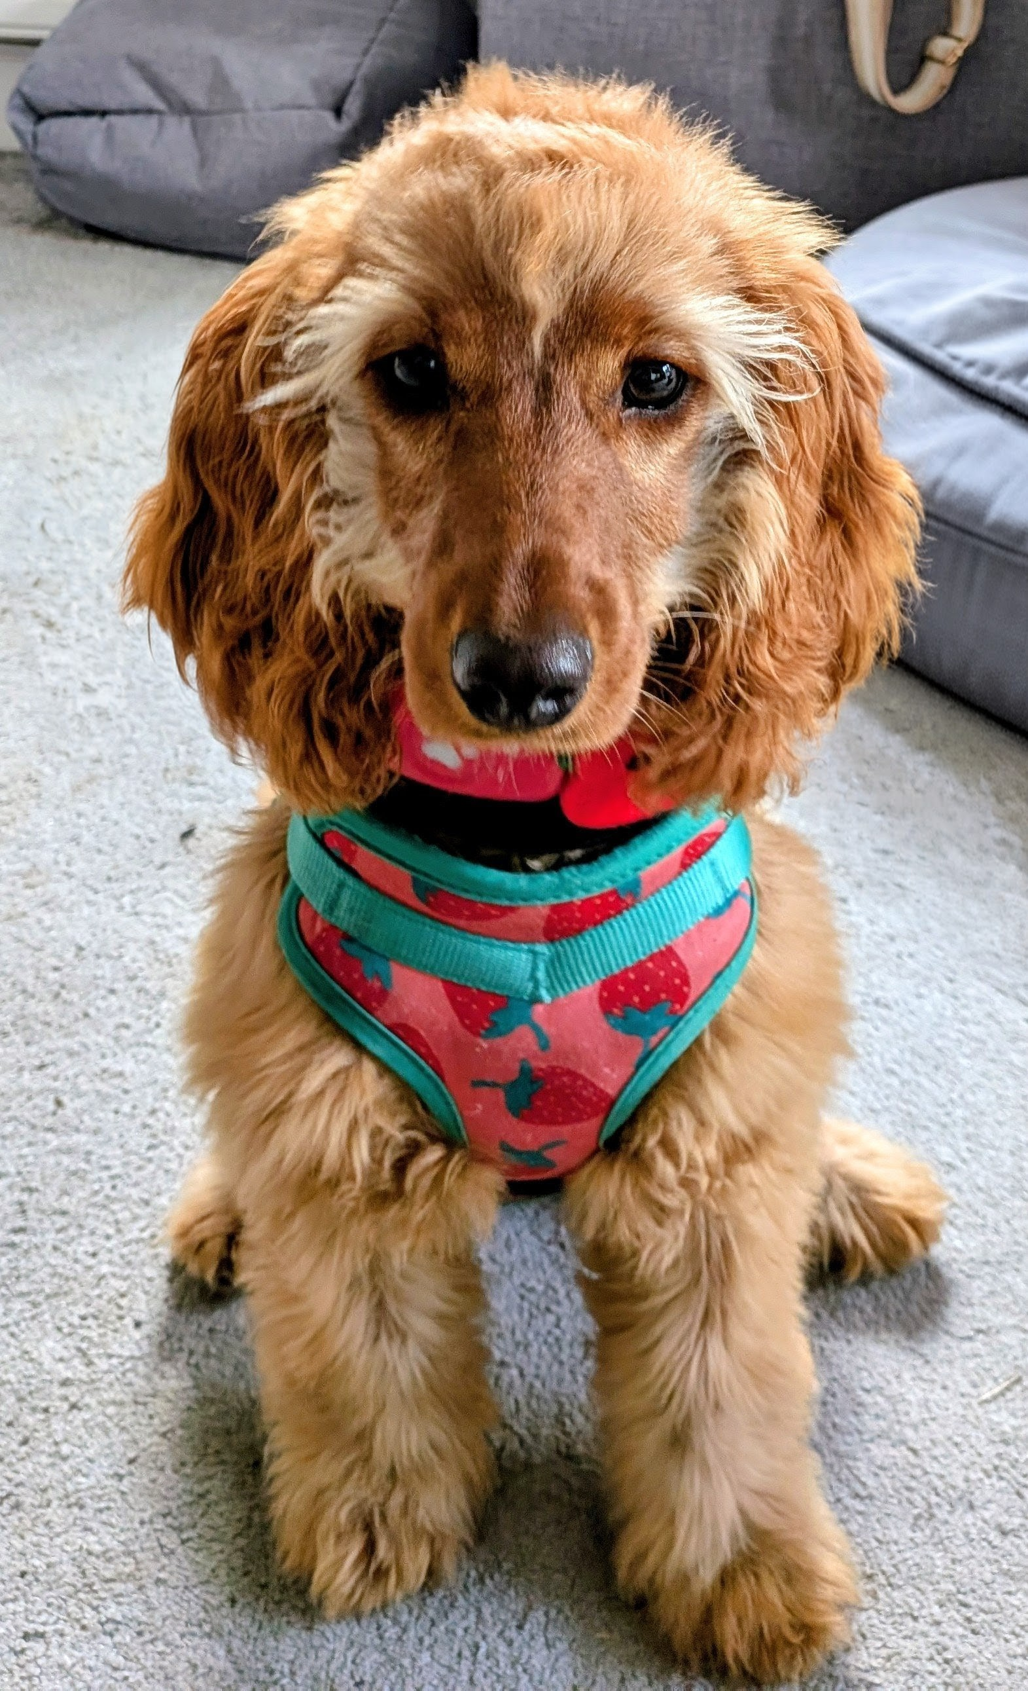

Hi!
My name is Honey.
I am a cockapoo.
I am 7 months old.
Honey

Slide 3

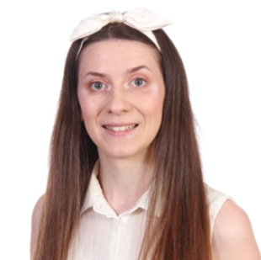
I live with Miss Ward.
and I will be working with all of you!

Slide 4

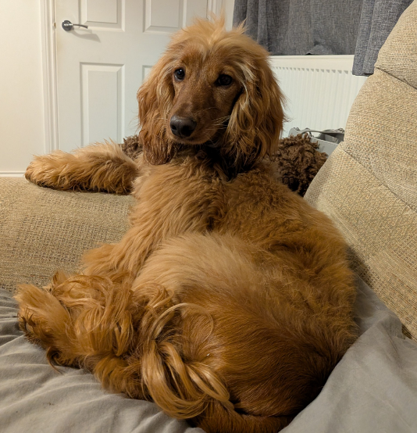
I’ve been working really hard training to be a school dog…
…but the training never stops!

Slide 5
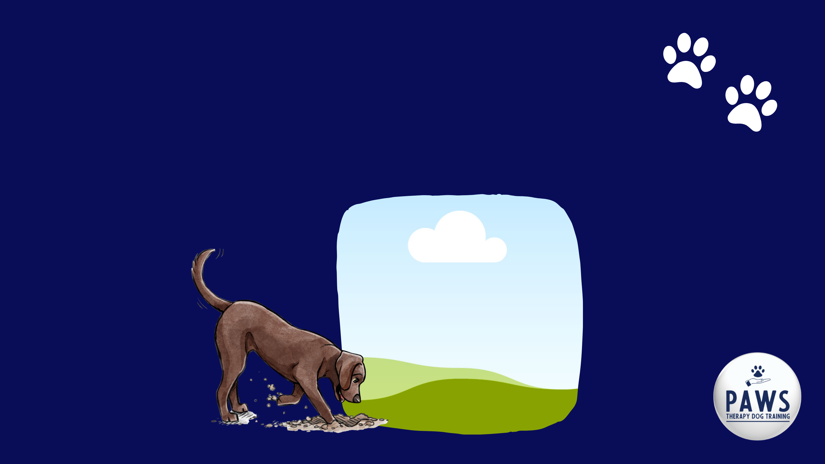
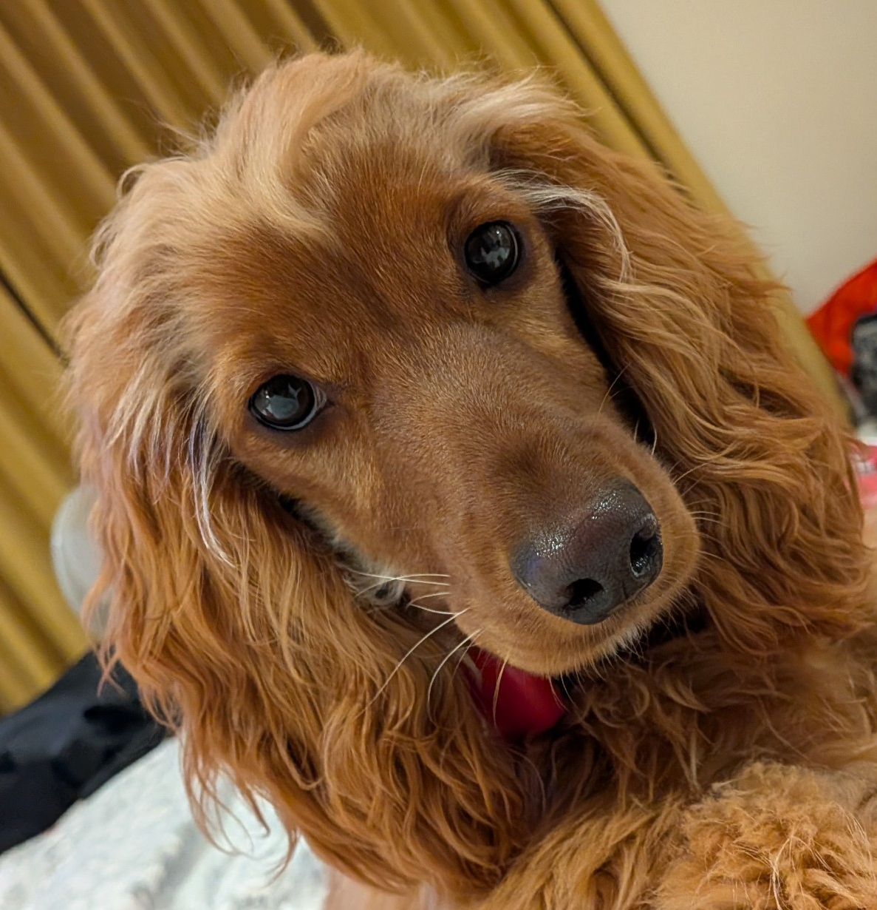
I need YOU to help me be the best school dog I can be.

Slide 6

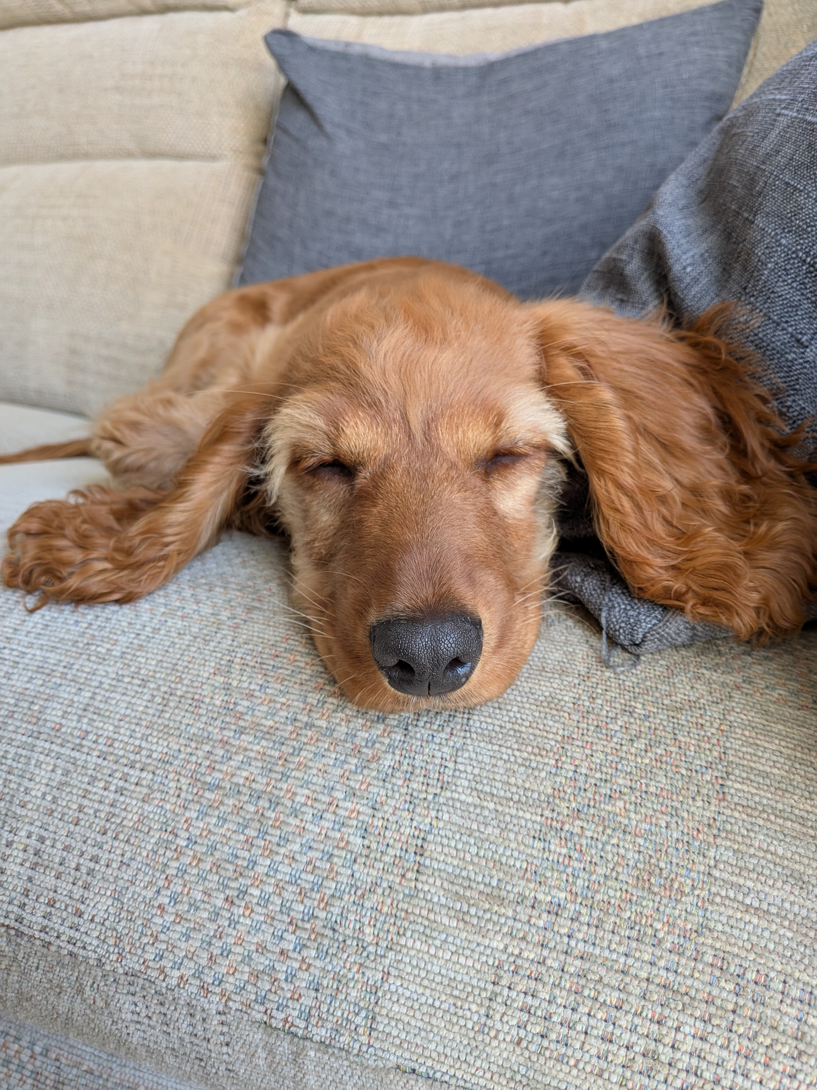
Dogs have very sensitive ears so being calm and quiet when near me will help

Slide 7

These things can help:
Please ask to say hello to me before saying my name or touching me.
Try not to leave food on the floor as it is very tempting for me to eat it and it could distract me or make me poorly.

Slide 8
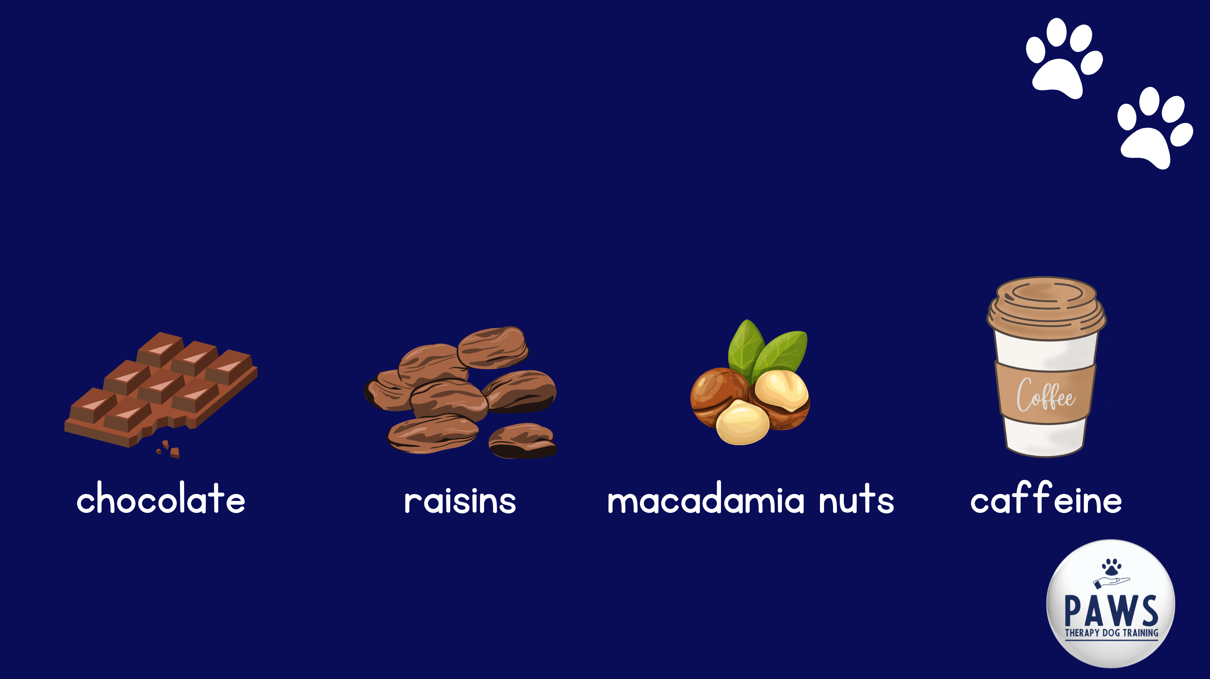
These things can help:
These foods are poisonous so please be extra safe with these

Slide 9

These things can help:
When I am in the corridor or walking somewhere please don't distract me - I have a job to do. I will say hello to you another time.
When you come to say hello to me, please listen to my body language and follow my lead. Do I want to be touched/stroked? How do you know?

Slide 10


Watch this video it will help you learn about dog body language

Slide 11

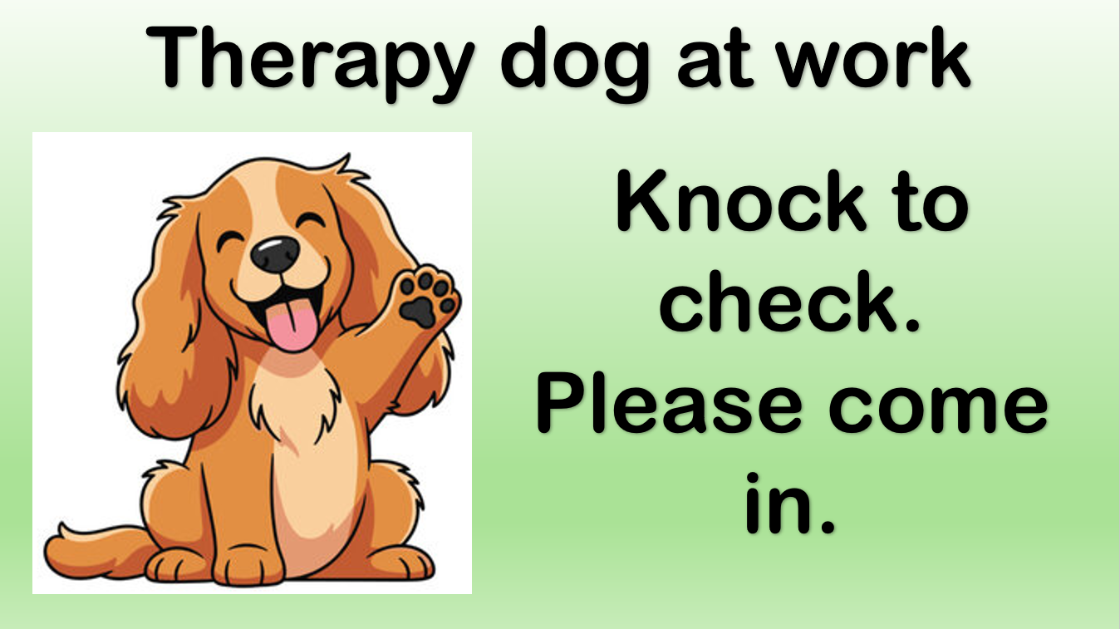
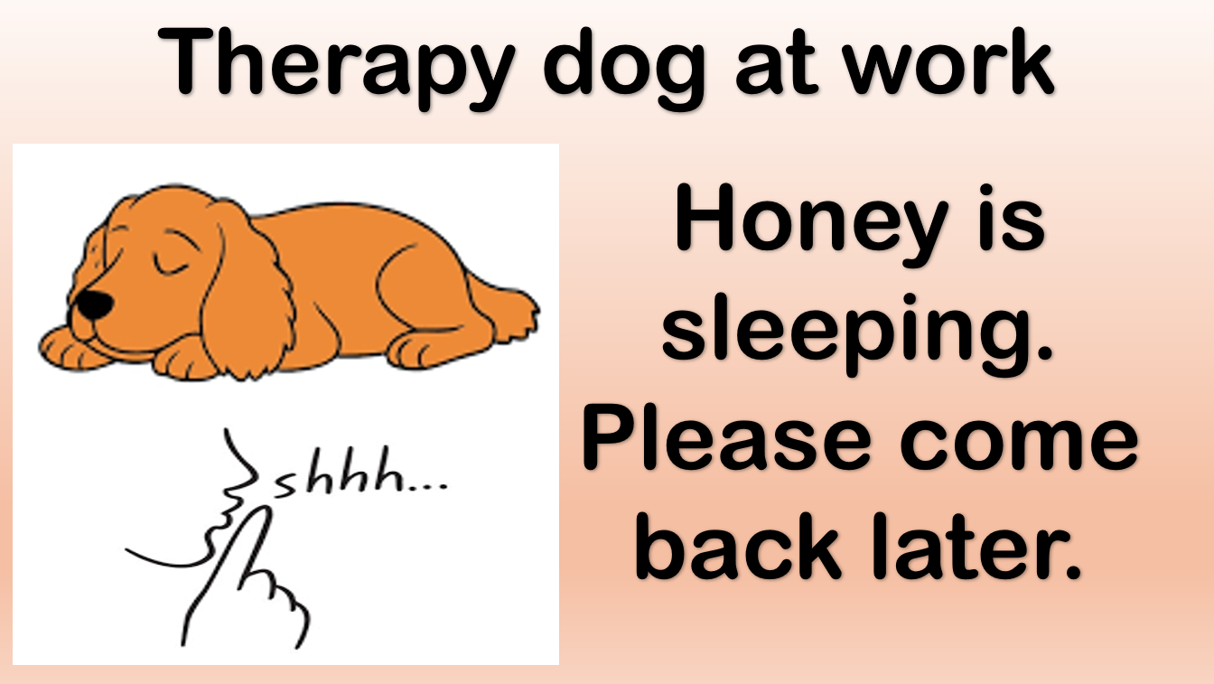
You will know when I'm at school because a sign will be up on Allen class door or the TIS room.

Slide 12
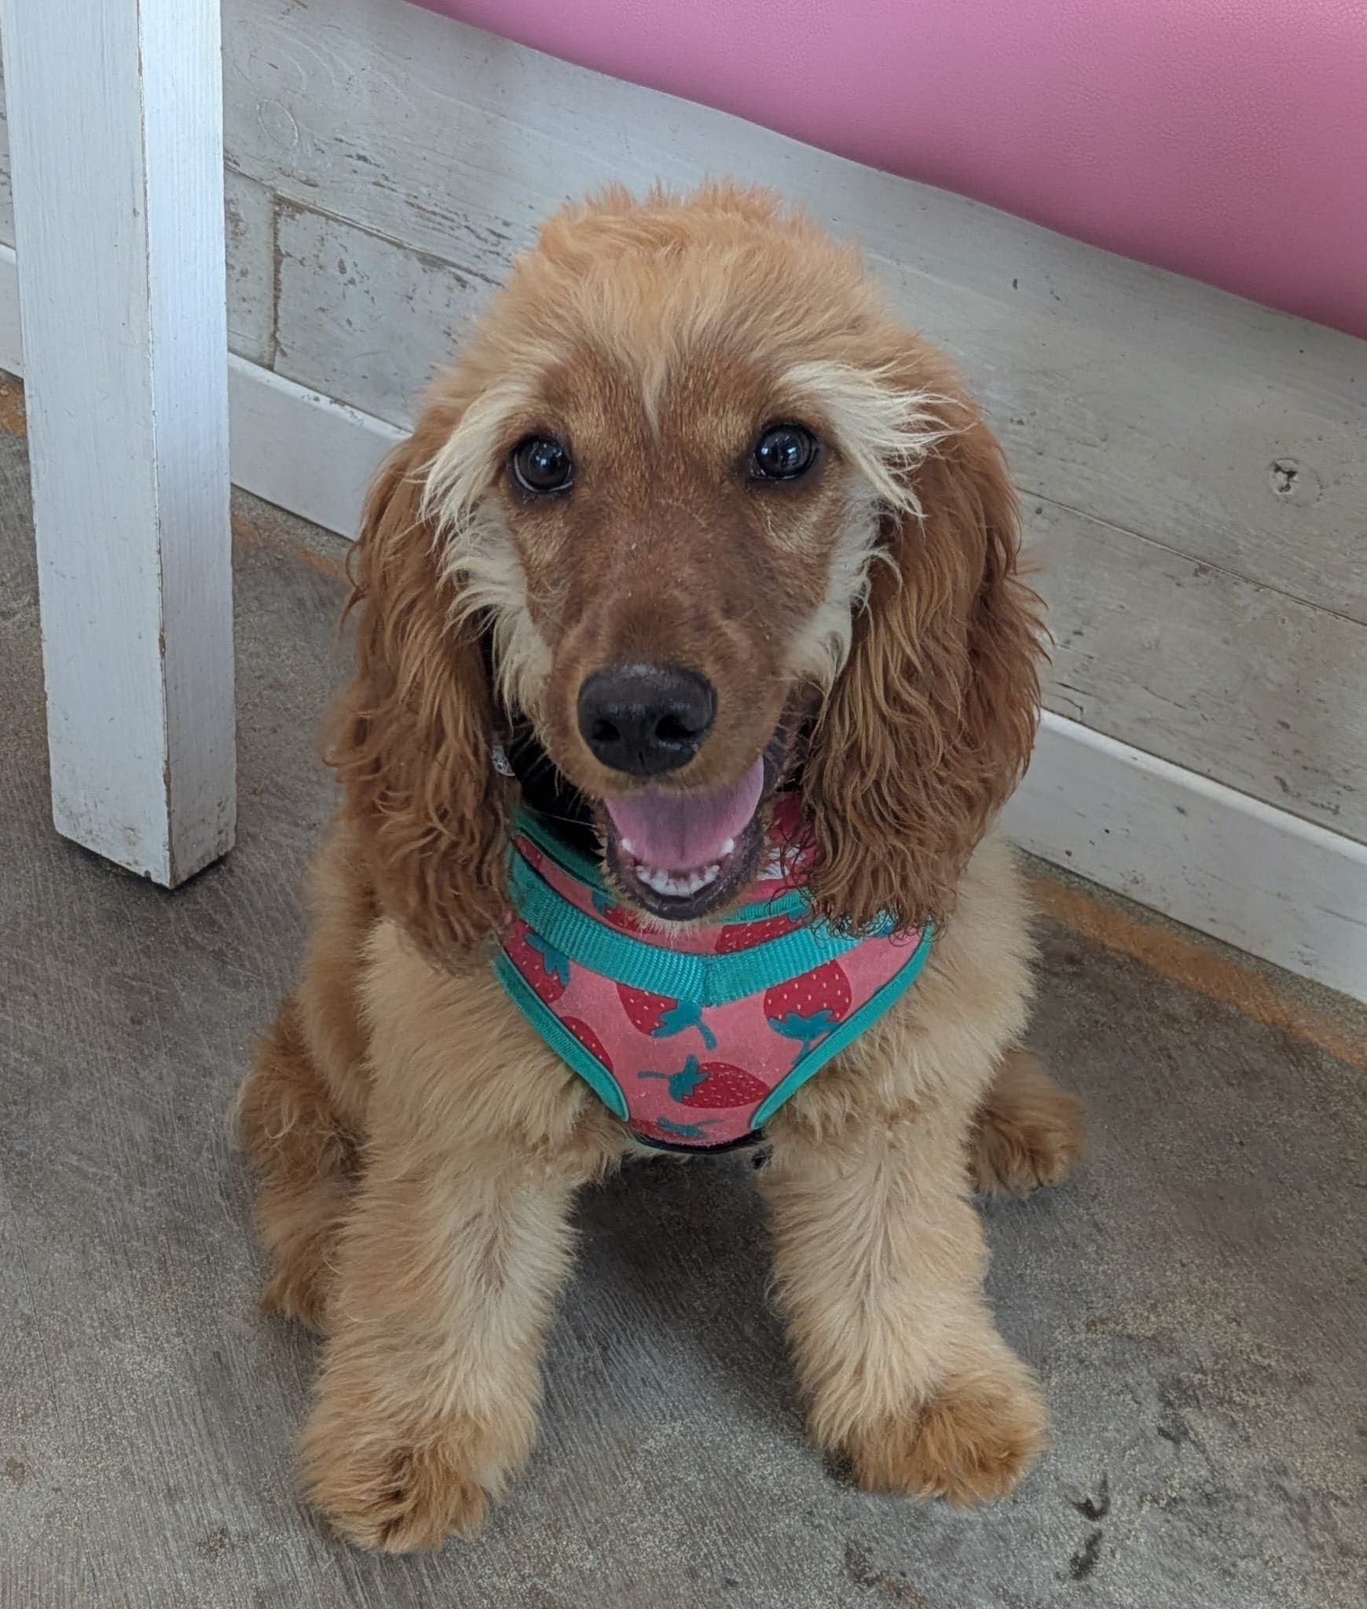
Thank you for helping me!

