Slide 1

WHO IS
PAWS
THERAPY &
ASSISTANCE DOG
TRAINING LTD?

Slide 2

PAWS Therapy & Assistance Dog Training is one of the UK's Leading authorities on Animal Assisted Learning, Animal Assisted Interventions and Assistance Dog Training.
PAWS proudly support hundreds of professionals such as counsellors, therapists, teachers, dog trainers, educational establishments and organisations to safely and ethically incorporate dogs to assist in providing essential wellbeing and mental health support. As well numerous families in training their dog to support them in everyday life.

Slide 3
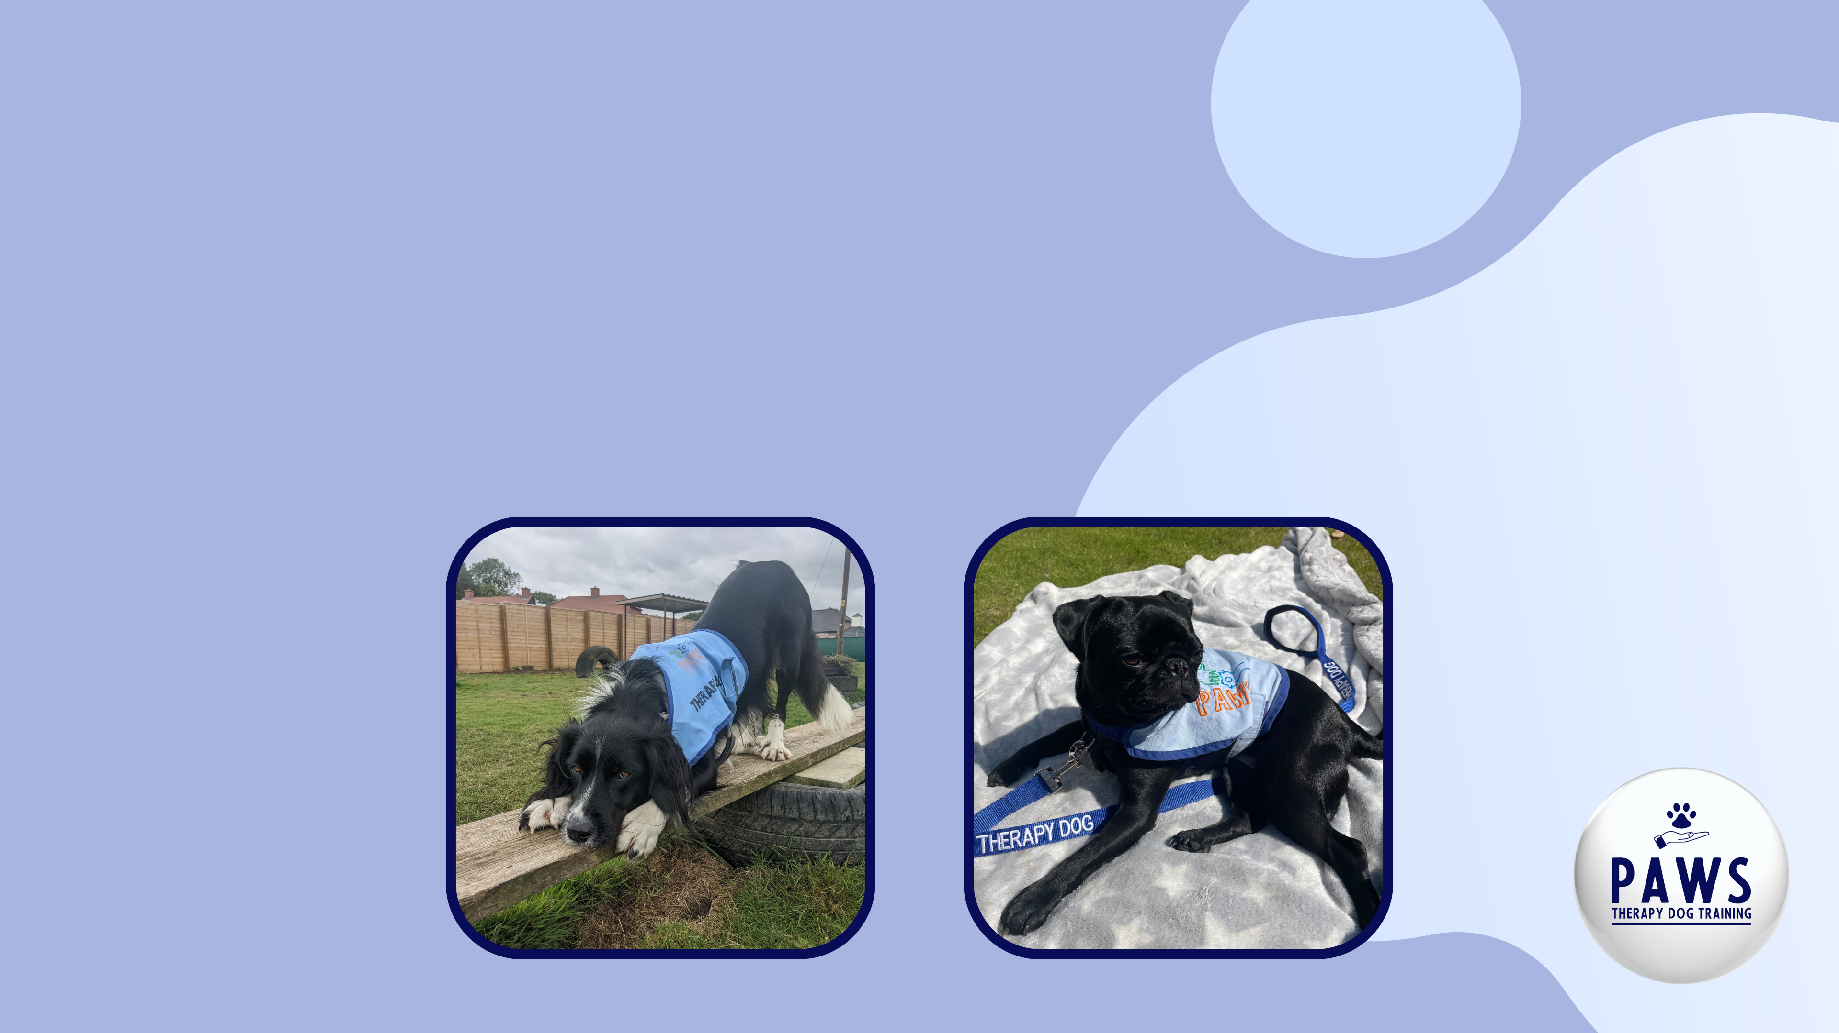
PAWS Therapy & Assistance Dog Training are the sister company to People and Animal Wellbeing Services CIC who have been providing Animal Assisted Interventions to hundreds of children, young people and adults since 2020.

Slide 4
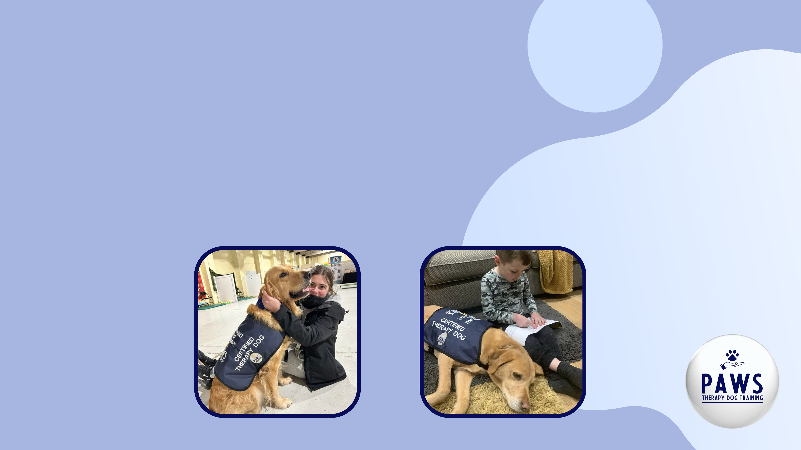
PAWS Therapy & Assistance Dog Training offer 5 different training programmes designed for different individuals.
Certification Programme - therapists, counsellors
Schools Programme - teachers, schools, organisations
Trainer Programme - dog trainers and behaviourists
Volunteer Programme - general public
Assistance Dog Programme - families/individuals diagnosed with neurological conditions and physical disabilities.

Slide 5

We are taking part in the PAWS Schools Programme!
The focus of this course is on:
school dog handling
school dog training skills
dog body language
dog law and legislation
canine first aid
intervention techniques and strategies
We will be assessed on our theory understanding and
complete an in-person practical assessment. This enables PAWS to check our understanding of AAE, law and dog communication skills. As well as observe the handling skills and welfare of the dog.

Slide 6

The PAWS Therapy & Assistance Dog Training Team are always there to support those enrolled on the training programmes.
We have access to join weekly live supervisions and if we ever have any questions then we can ask in the Facebook group or email.
The PAWS Facebook group is a great community of like-minded people who are all going through the same thing as us!

